Slide 1
Data Curation Project:
Movies
Group 19
Lisa He
Chris Chen

Slide 2
Dataset
Movies Daily Update Dataset (kaggle.com)
~350 MB
20 columns containing metadata for each movie
>700,00 rows of movie data collected from the TMDB database
The Movie Database (TMDB) is a popular, user editable database for movies and TV shows.
Note: The dataset on Kaggle is updated daily and our working dataset is up to date as of 2023-11-14.

Slide 3
Description of Dataset
Original Attributes
'Id'
'Title'
'Genres'
'Original_language'
'Overview'
'popularity'
'Release_date'
'Budget'
'Revenue'
‘Runtime’
‘Status’
‘Tagline’
‘Vote_average’
‘Vote_count’
‘Credits’
‘Keywords’
‘Poster_path’
‘Backdrop_path’
‘Recommendations’

Slide 4
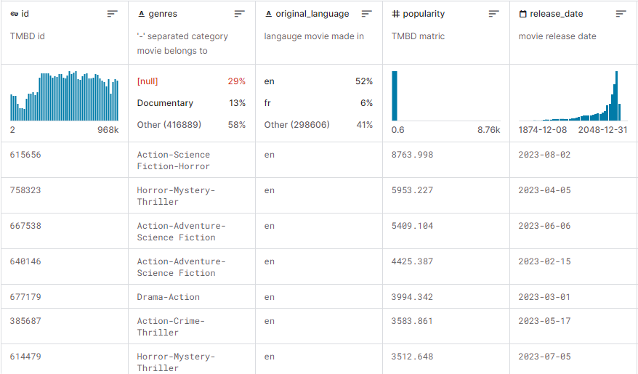
Dataset Snapshot
Notes:
This is a snapshot of the dataset in Kaggle. We used this to quickly identify a dataset that contained plenty of opportunities to clean.

Slide 5
Challenges

Slide 6
Vizier's 100MB File Size Limit
Solution: Do a rough cleaning to remove largely empty columns and take a subset of the dataset
Notes:
The first challenge we faced was the 100MB file size limit on Vizier. To get around this, we did a quick cleaning and used a subset of the original before we delve any deeper into the dataset.

Slide 7
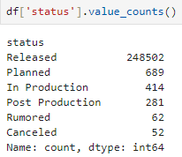
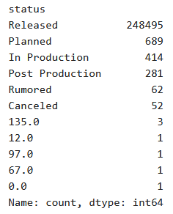
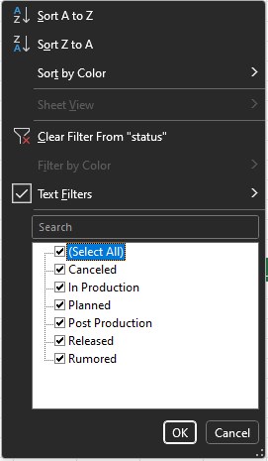
Vizier can incorrectly read CSV files
Jupyter Notebook: Vizier: Excel:
Notes:
Another challenge we ran into was when we tried to work in different environments. For example in the status column, we see 6 distinct responses in Python, but when the same code was run in Vizier, there appeared to be 5 more. We had to investigate this by looking at the raw file in Excel. There were 6 possible values in the original dataset as well, which indicated that the problem might be with how Vizier was reading the dataset.

Slide 8
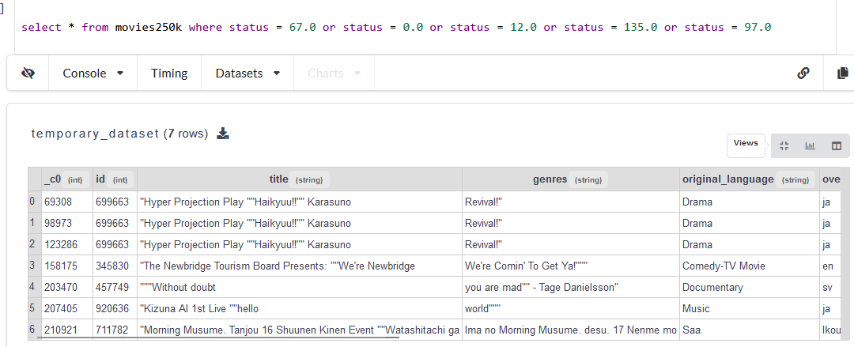
Vizier can incorrectly read CSV files
Vizier
Notes:
We needed to know how many movies were affected. Running this SQL query yielded 7 results. At first glance, the columns appeared to be shifted over by one column. Part of the title was in the genres column, the genre values were in the language column, and so on.

Slide 9
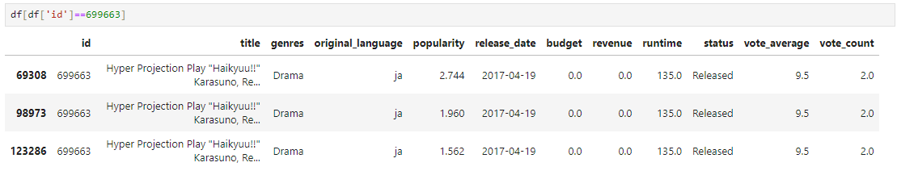
Vizier can incorrectly read CSV files
Jupyter Notebook
Notes:
We also checked outside of Vizier but could not replicate the issue.

Slide 10
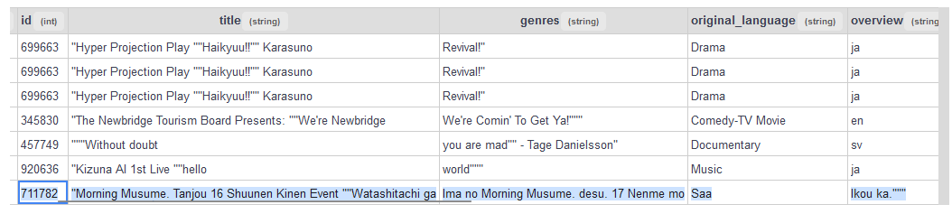
Vizier can incorrectly read CSV files
Vizier
Row 6: Morning Musume. Tanjou 16 Shuunen Kinen Event "Watashitachi ga, Ima no Morning Musume. desu. 17 Nenme mo, Saa, Ikou ka.
Notes:
Coming back to the Vizier results, we can see row 6 contains a title with multiple commas. Each of these were incorrectly read as a delimiter in Vizier which we can see has shifted the columns more than once. However, there were multiple other movie titles with commas that parsed with no problem. We also attempted converting the dataset into JSON and Excel files but ran into timeout issues so to avoid spending too much time on the environment, we decided to work in a Jupyter notebook since we would be using mostly Python anyways.

Slide 11
Data Precleaning
Notes:
Once we got over that hurdle, we could start to really do cleaning.

Slide 12
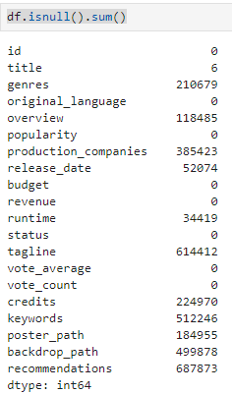
Initial Steps
The file is too large for Vizier (100MB cap)
Check for null values in the larger dataset using Jupyter notebook
Remove columns that are largely null values or unhelpful for our end goal
Notes:
Let's rewind to getting the data into Vizier. To get past the file size limit, we checked for null values and removed the columns that contained a high percentage of missing values. Fortunately the column names are descriptive so we could remove columns without it affecting any correlations.

Slide 13
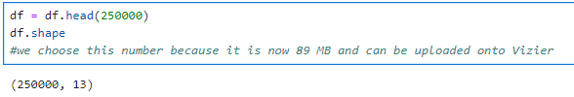
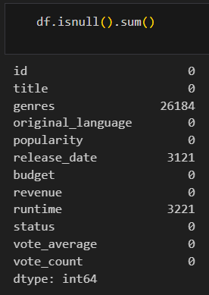
Initial Steps (cont.)
3. Choose the first 250,000 values to lower the size down to ~90MB
Notes:
And we took a subset of 250,000 entries which shaved the size down to 89MB. The dataset used for the project contains these 13 attributes.

Slide 14
Data Cleaning

Slide 15
Issue: Missing Values and Outliers
Some entry values appear to be invalid or outliers
Many movies have a runtime of 0 minutes
Upon closer look there is a valid entry for a documentary with a runtime of 51,420 minutes (Logistics, 2012)
Notes:
Issues discovered include missing values and outliers, though one movie has a valid runtime of more than 50k minutes. Some columns contained more than 90% missing values. Some columns used a default value of 0 which might pose an issue. For example the average vote is a default of 0 if there are no voters. The genres column allows multiple genres but is stored as a single string. The release date entries contained strings and dates in different formats.

Slide 16
Solution: Missing Values and Outliers
Missing values:
Release date: impute with column mode
Genres: impute with "unknown"
Runtime: impute with column mean
Outliers:
Filled with column mean or mode
Some extreme values can be removed – unfortunately this means the record-breaking entry with a runtime of 51,420 minutes will be removed

Slide 17
Default Values
Issue:
Column-specific answers, e.g. for column vote_average, the values can only be from 0 to 10 and have a default value of 0
Revenue and budget also default to 0; some entries contain budget and invalid revenue, or vice versa
Solution:
vote_average: replace default '0' with mode if there is a significant number of vote counts
Revenue and budget left as is (>90% contain missing values)

Slide 18
Genres Column
Issue:
Values are delimited with a hyphen ('-') but are in the same column
Cannot fill with column mode since the genres are evenly spread out and that would lead to information loss
Solution:
Replaced missing or invalid values with a default value ("unknown")
Generate dummy variables for genres

Slide 19
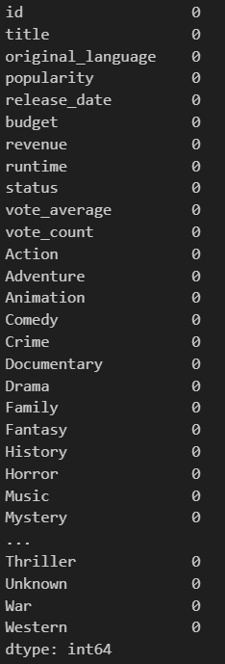
Final Dataset
250,000 data points maintained
32 columns
0 missing values
Notes:
Now the dataset is cleaned and can be used for analysi

Slide 20
Visualizations
Notes:
As an example, we chose to do some visualizations using Seaborn

Slide 21
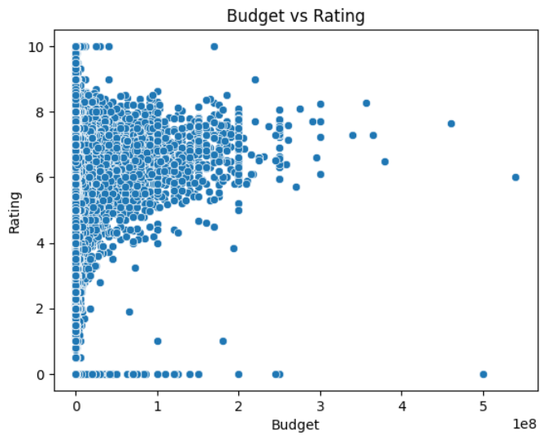
Notes:
Here is a budget vs rating plot using the cleaned ratings column

Slide 22
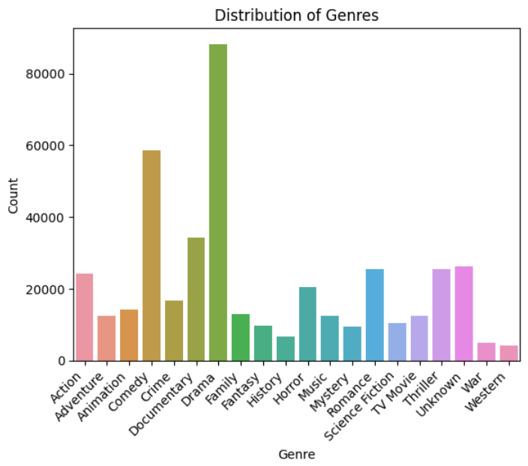
Notes:
Here is the distribution of genres since we binarized them

Slide 23
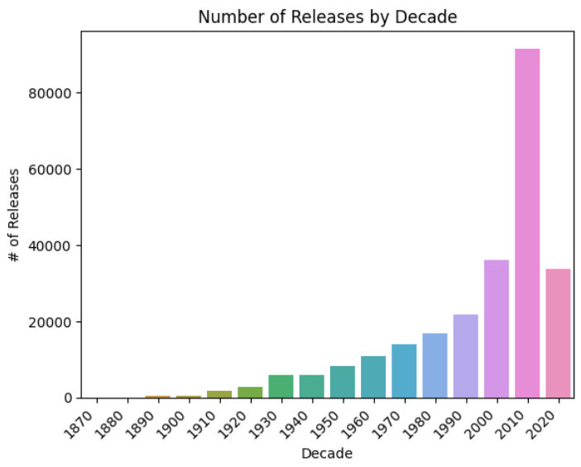
Notes:
And here is a distribution of releases by decade

